Slide 1
COMP 2000
Week 5 - Friday

Slide 2
Last time
What did we talk about last time?
GUIs
JOptionPane

Slide 3
Questions?

Slide 4
Project 2

Slide 5
JFrame

Slide 6
JFrame
JOptionPane was fine for creating a limited range of dialogs
If we want to make a whole window, we use JFrame
Java uses the term frame instead of window, probably because of concerns about lawsuits from Microsoft
But when you hear JFrame, think "main window"

Slide 7
Creating or extending
When designing a JFrame, there are two meaningful options:
Creating a JFrame object and adding stuff to it inside of some other class
Extending JFrame with your own class, making your class a JFrame plus more
It doesn't really matter which one you pick
To keep things simple, we'll create a JFrame object instead of extending the JFrame class

Slide 8
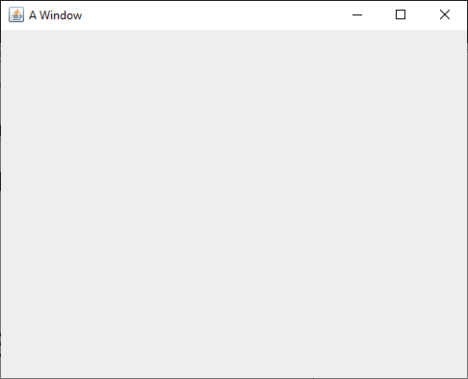
Creating a JFrame
To create a JFrame, we will usually call its constructor that takes a String, giving it a title
Then, we have to make it visible so that we can see it
JFrame frame = new JFrame("A Window");
frame.setVisible(true);

Slide 9
setSize()
The code from the previous slide will make a JFrame and make it visible
However, it will probably be so small that you won't even notice it
To deal with this problem, you should set its size, ideally before you make it visible
Its setSize() method takes two int values: width and height in pixels
Eventually, once we add widgets to a JFrame, we can simply call its pack() method, which will make it take up the amount of space it needs to fit everything
JFrame frame = new JFrame("A Window");
frame.setSize(500, 400);
frame.setVisible(true);

Slide 10
setDefaultCloseOperation()
Next, you'll notice that closing the window doesn't end the program
The little red square on the Eclipse Console is still clickable, meaning that the program is running
By default, closing the window by clicking its X only hides the window
By calling the setDefaultCloseOperation(), we can make it so that the default operations is dispose (getting rid of the window)
Many books suggest passing in JFrame.EXIT_ON_CLOSE, but you should not!
Doing so will kill the rest of your program like System.exit()
JFrame frame = new JFrame("A Window");
frame.setSize(500, 400);
frame.setDefaultCloseOperation(JFrame.DISPOSE_ON_CLOSE);
frame.setVisible(true);

Slide 11
Recap
To use a JFrame you must:
Create a JFrame object
Set its size (either directly or by putting widgets on it and then calling pack())
Set its default close operation to dispose
Make it visible
Now that we've got a window, we can put widgets on it!

Slide 12
Widgets

Slide 13
Widgets
Widget is a generic term for a wide range of GUI controls
Buttons
Labels (allowing us to put text or images on a GUI)
Text fields
Text areas (like text fields but larger)
Menus
Checkboxes
Radio buttons
Lists
Combo boxes
Sliders

Slide 14
JButton
A button you can click on is provided by the JButton class
A JButton is usually created with text or an image
You'll need to make JButtons with images for Project 2
Just creating the JButton doesn't do anything
You have to add it to a JFrame (or other container) to see it
Right now, we're just creating the buttons
Next week, we'll learn how to add actions to them
JButton button = new JButton("Push me!");

Slide 15
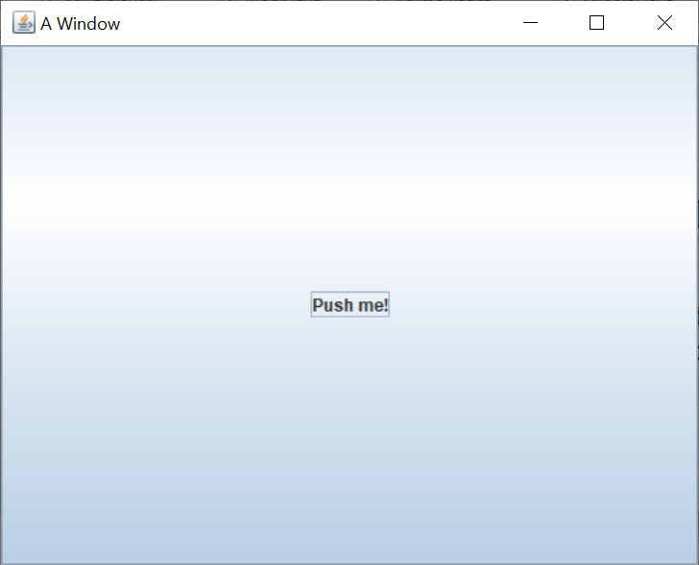
Adding a JButton to a JFrame
Once you've created a JButton, you can add it to a JFrame by calling the add() method on the JFrame
All GUI containers have an add() method that allows us to add a widget to it
JFrame frame = new JFrame("A Window");
frame.setSize(500, 400);
frame.setDefaultCloseOperation(JFrame.DISPOSE_ON_CLOSE);
JButton button = new JButton("Push me!");
frame.add(button);
frame.setVisible(true);

Slide 16
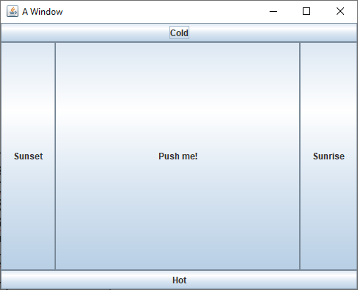
Adding to different parts of a JFrame
By default, a JFrame uses a layout manager called the BorderLayout that has five region
Calling the simplest add() method adds a widget to the center, which stretches to take up all available space
You can specify that you're adding to:
BorderLayout.CENTER
BorderLayout.NORTH
BorderLayout.SOUTH
BorderLayout.EAST
BorderLayout.WEST
JButton centerButton = new JButton("Push me!");
frame.add(centerButton, BorderLayout.CENTER);
JButton northButton = new JButton("Cold");
frame.add(northButton, BorderLayout.NORTH);
JButton southButton = new JButton("Hot");
frame.add(southButton, BorderLayout.SOUTH);
JButton eastButton = new JButton("Sunrise");
frame.add(eastButton, BorderLayout.EAST);
JButton westButton = new JButton("Sunset");
frame.add(westButton, BorderLayout.WEST);

Slide 17
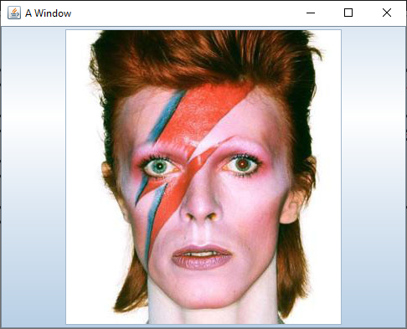
Displaying an icon on a JButton
You can also make a JButton with an image instead of text
To do so, you create an ImageIcon and pass that to the constructor of the JButton
You'll need the path to an image
JButton bowieButton = new JButton(new ImageIcon("bowie.jpg"));
frame.add(bowieButton, BorderLayout.CENTER);

Slide 18
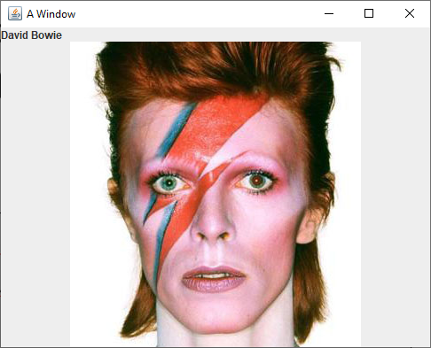
JLabel
A JLabel is like a button you can't click
Its constructors work just like the JButton ones
It allows you to display text or an image
JLabel nameLabel = new JLabel("David Bowie");
JLabel bowieLabel = new JLabel(new ImageIcon("bowie.jpg"));
frame.add(nameLabel, BorderLayout.NORTH);
frame.add(bowieLabel, BorderLayout.CENTER);

Slide 19
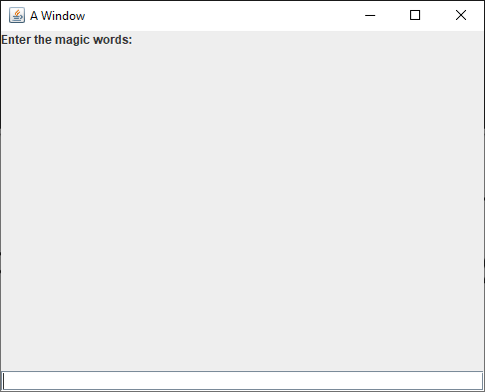
JTextField
A JTextField allows a user to enter a (short) amount of text
Usually, you'll need a JLabel to tell the person what they should enter
The example is ugly because the JLabel and the JTextField don't fill the 500 x 400 JFrame
JLabel messageLabel = new JLabel("Enter the magic words:");
JTextField magicField = new JTextField();
frame.add(messageLabel, BorderLayout.NORTH);
frame.add(magicField, BorderLayout.SOUTH);

Slide 20
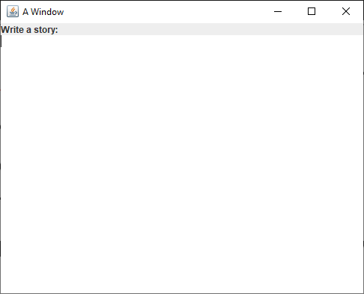
JTextArea
A JTextField is for entering small pieces of information
Name
Address
Telephone number
For larger texts, we can use a JTextArea
JLabel storyLabel = new JLabel("Write a story:");
JTextArea storyArea = new JTextArea();
frame.add(storyLabel, BorderLayout.NORTH);
frame.add(storyArea, BorderLayout.CENTER);

Slide 21
Layout Managers

Slide 22
Layout managers
When you add a widget to a JFrame (or to a JPanel), its layout manager determines how it will be arranged
There are lots of layout managers, but it's worth mentioning four:
BorderLayout
GridLayout
FlowLayout
BoxLayout
Note that we won't talk about BoxLayout, but you should look it up if you get serious about Swing GUIs
BoxLayout makes it easy to arrange widgets in a horizontal or vertical line, with different amount of spacing between widgets

Slide 23
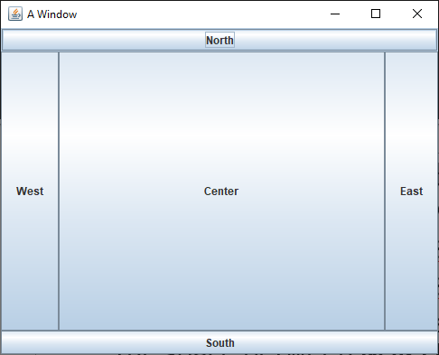
BorderLayout
BorderLayout is the default layout for JFrame
When you add widgets, you can specify the location as one of five regions:
BorderLayout.NORTH stretches the width of the container on the top
BorderLayout.SOUTH stretches the width of the container on the bottom
BorderLayout.EAST sits on the right of the container, stretching to fill all the space between NORTH and SOUTH
BorderLayout.WEST sits on the left of the container, stretching to fill all the space between NORTH and SOUTH
BorderLayout.CENTER sits in the middle of the container and stretches to fill all available space
If you don't specify where you're adding a widget, it adds to CENTER
If you add more than one widget to a region, the new one replaces the old
Unused regions disappear

Slide 24
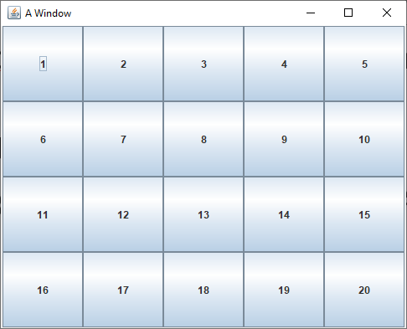
GridLayout
GridLayout allows you to create a grid with a specific number of rows and columns
All the cells in the grid are the same size
As you add widgets, they fill each row
frame.setLayout(new GridLayout(4, 5));
for(int row = 0; row < 4; ++row)
for(int column = 0; column < 5; ++column)
frame.add(new JButton("" + (row * 5 + column + 1)));

Slide 25
Quiz

Slide 26
Upcoming

Slide 27
Next time…
More on layout
Action listeners

Slide 28
Reminders
Keep reading Chapter 15
Keep working on Project 2

